Slide 1
The Recovery Quotient:
Our group was interested in comparing how long sectors took to recovery from multiple different recessions.
For the comparison to be meaningful it wasn’t appropriate to measure recovery in days.
A shallow recession would likely take fewer days to recover from than a deeper one.
Recessions:
GFC
COVID
DOTCOM
A measure of how long recovery takes relative to the length of the recession.

Slide 2
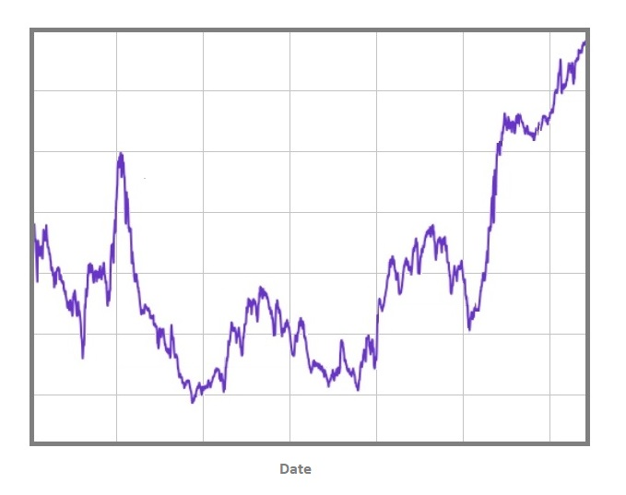

Slide 3
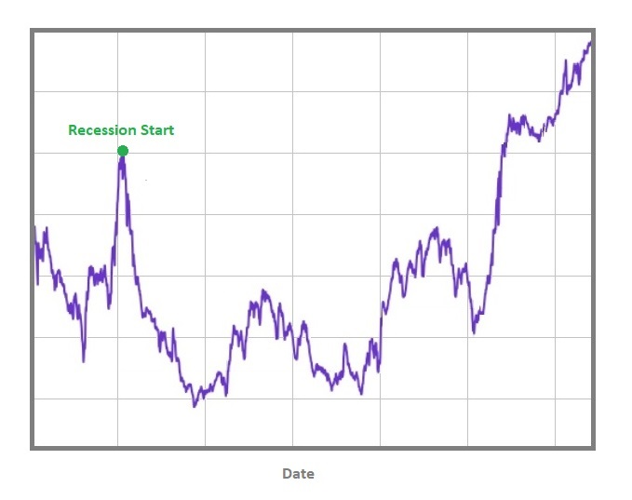

Slide 4
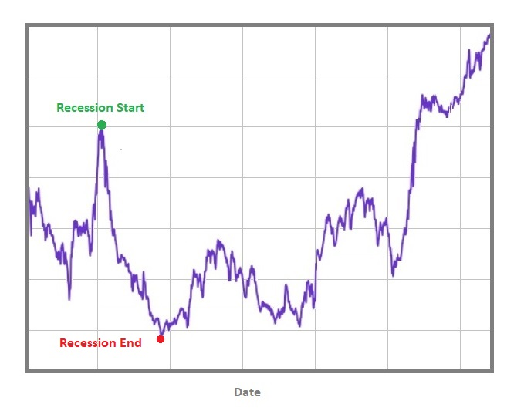

Slide 5
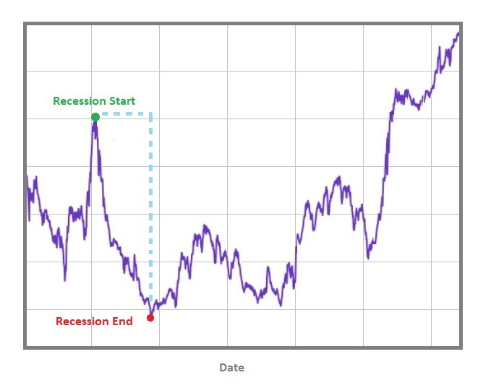

Slide 6
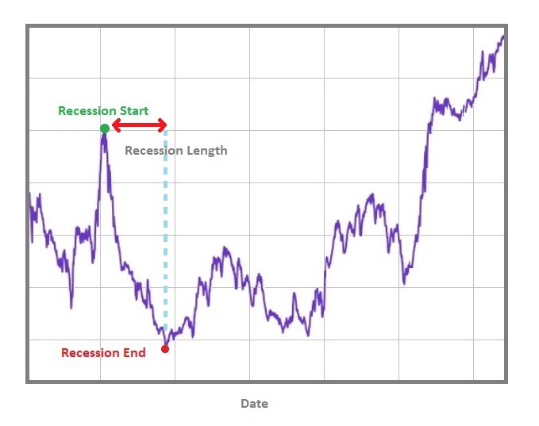

Slide 8
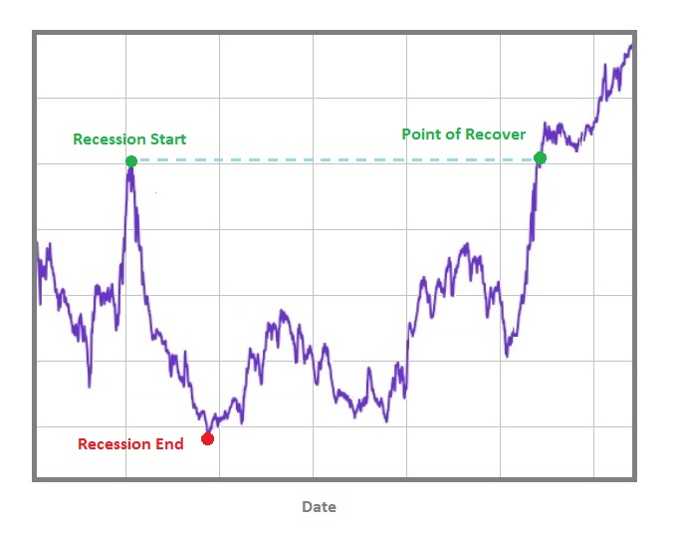

Slide 9
